Slide 1
Cellular Automaton Model for Mixed Traffic of Self-driving Cars and Human-driving Cars
Qian Xie and Zuzhao Ye
qianxie@nyu.edu
zy1451@nyu.edu

Slide 2
Reference
Single-lane CA model
Nagel, Kai, and Michael Schreckenberg. "A cellular automaton model for freeway traffic." Journal de physique I 2.12 (1992): 2221-2229.
Multi-lane CA model
Two-lane, symmetric passing rule
Rickert, Marcus, et al. "Two lane traffic simulations using cellular automata." Physica A: Statistical Mechanics and its Applications 231.4 (1996): 534-550.
Multi-lane, asymmetric passing rule
Wagner, Peter, Kai Nagel, and Dietrich E. Wolf. "Realistic multi-lane traffic rules for cellular automata." Physica A: Statistical Mechanics and its Applications 234.3-4 (1997): 687-698.

Slide 3
Outline
Introduction
Model
Simulation
Analysis
Conclusion

Slide 4
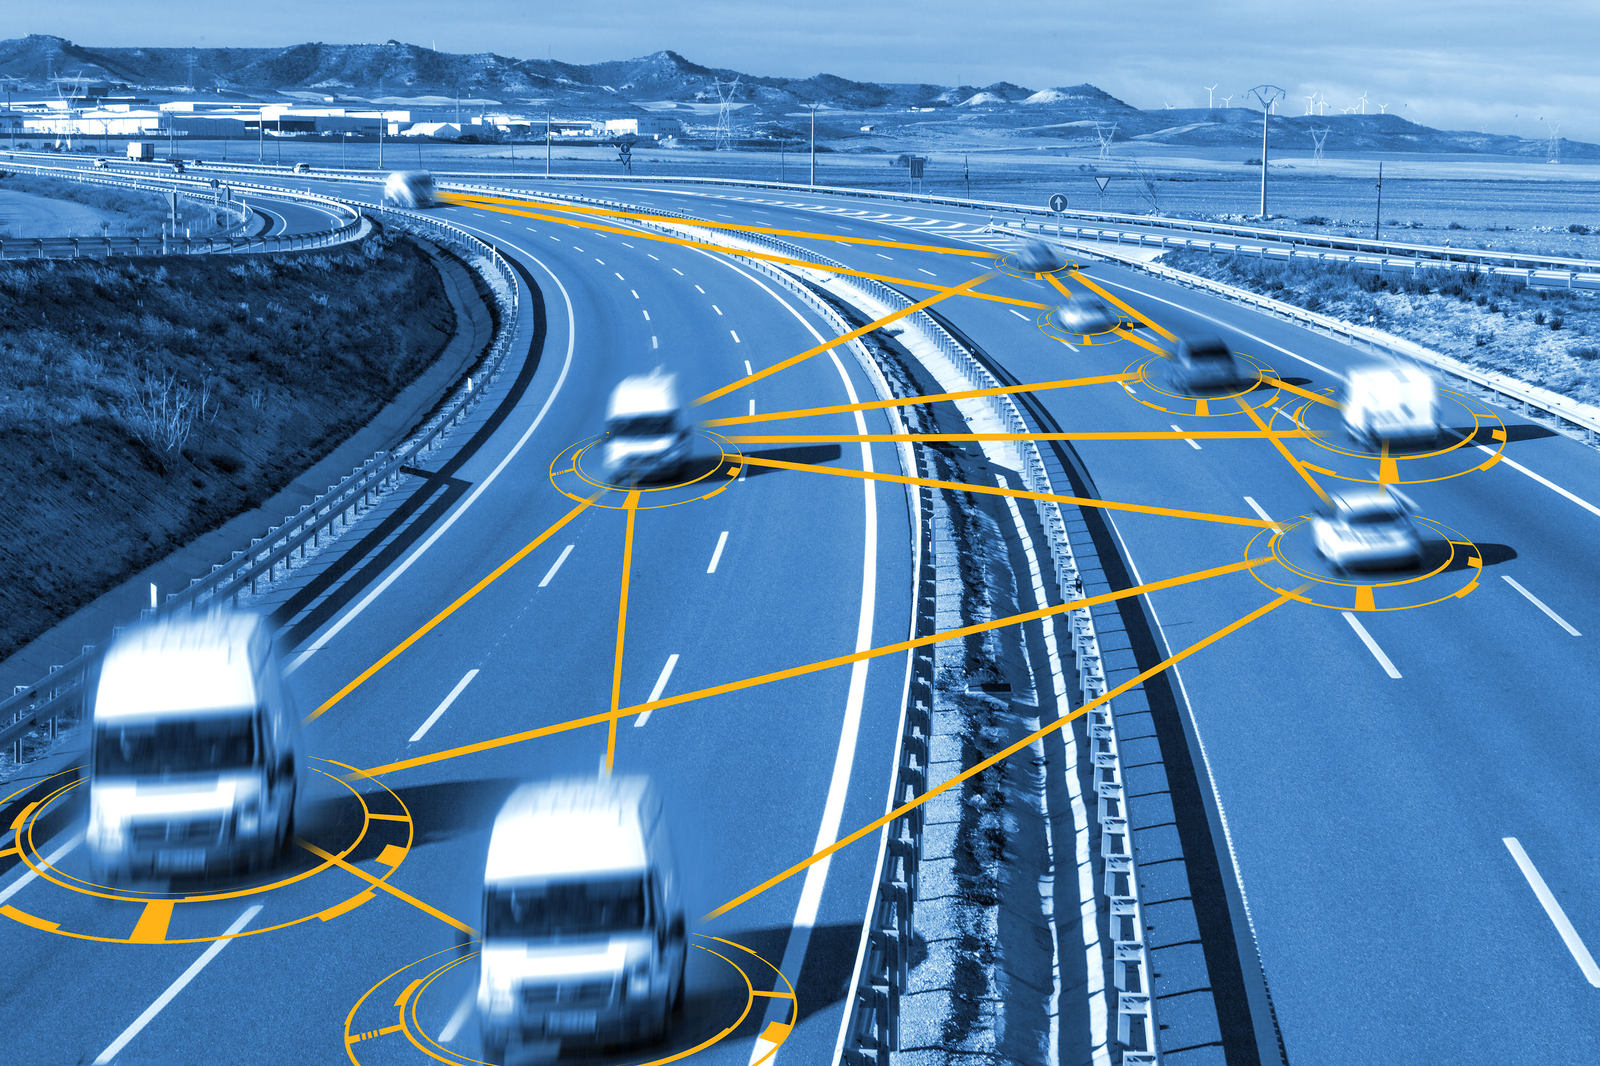
Introduction
Micro -> Macro
Sources:
https://giphy.com/gifs/programming-automata-cellular-rDHv0DV2LICdO
https://giphy.com/gifs/tetris-MOSebUr4rvZS0
https://www.justiceforyou.com/accidents/autonomous-vehicle-safety/

Slide 5
Model
Setup
Generation
Car-following
Lane-changing

Slide 6
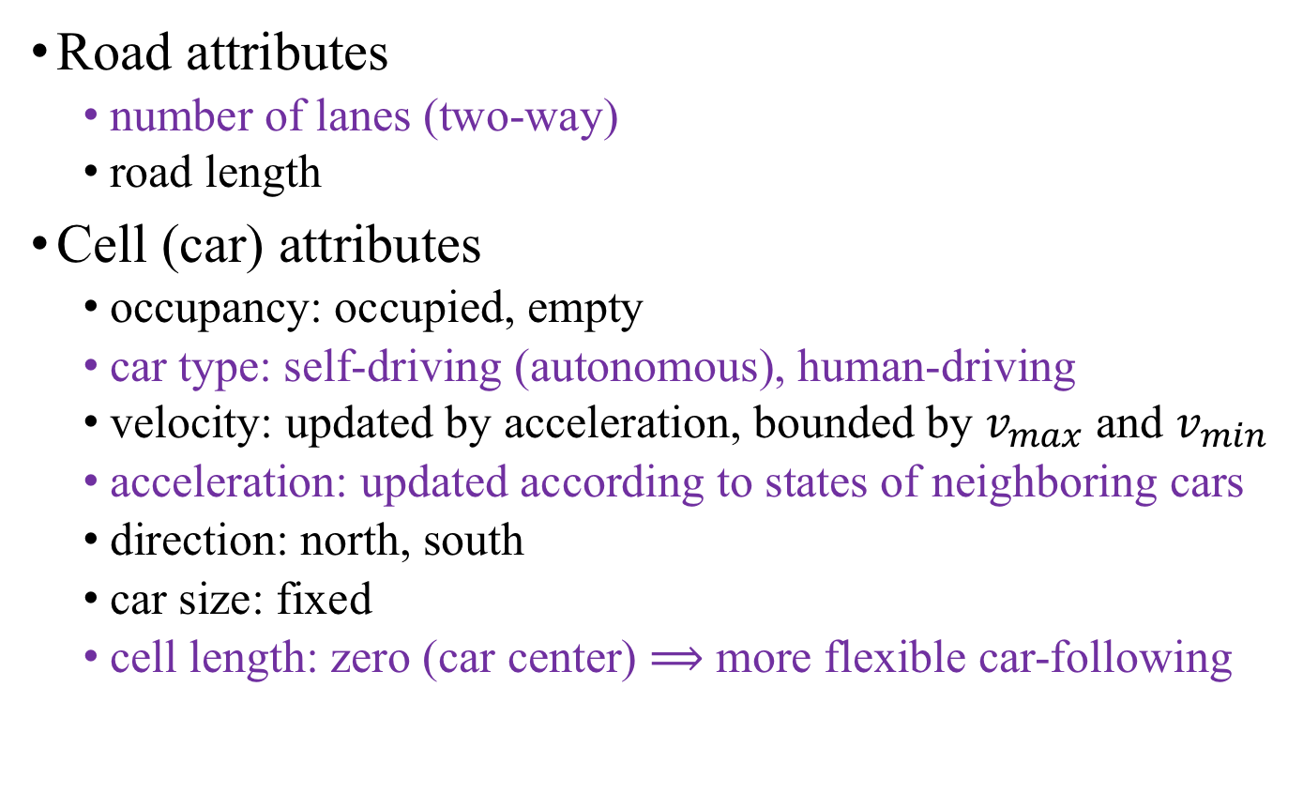
Setup
Road attributes
number of lanes (two-way)
road length
Cell (car) attributes
occupancy: occupied, empty
car type: self-driving (autonomous), human-driving
velocity: updated by acceleration, bounded by $v_{max}$ and $v_{min}$
acceleration: updated according to states of neighboring cars
direction: north, south
car size: fixed
cell length: zero (car center) $⟹$ more flexible car-following

Slide 7

Generation
Closed (periodic) boundary condition
Assign types
auto (resp. human) with probability $p$ (resp. $1−p$)
Sample initial velocity
from gaussian distribution

Slide 8
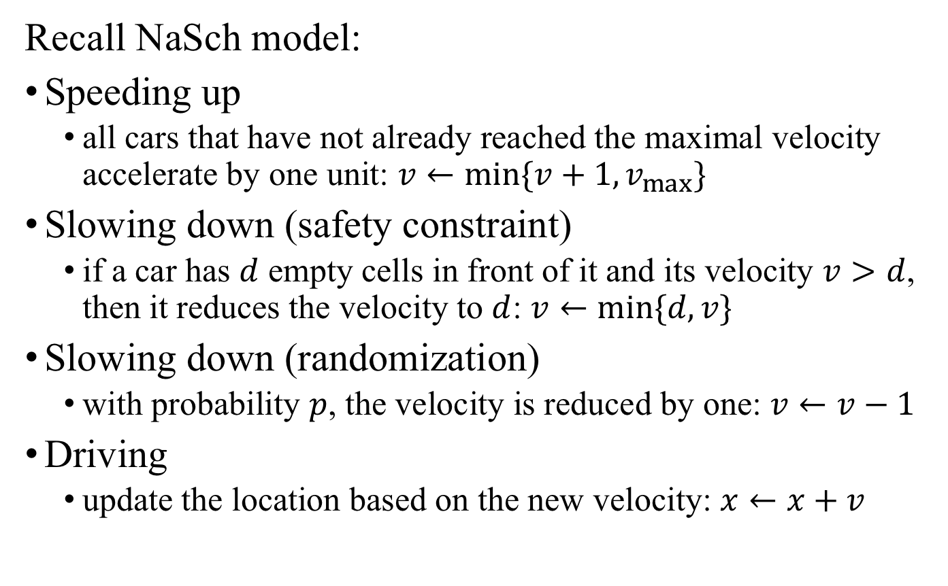
Car-following
Recall NaSch model:
Speeding up
all cars that have not already reached the maximal velocity accelerate by one unit: $v←min\{v+1,v_{max}\}$
Slowing down (safety constraint)
if a car has $d$ empty cells in front of it and its velocity $v>d$, then it reduces the velocity to $d$: $v←min\{d,v\}$
Slowing down (randomization)
with probability $p$, the velocity is reduced by one: $v←v−1$
Driving
update the location based on the new velocity: $x←x+v$

Slide 9
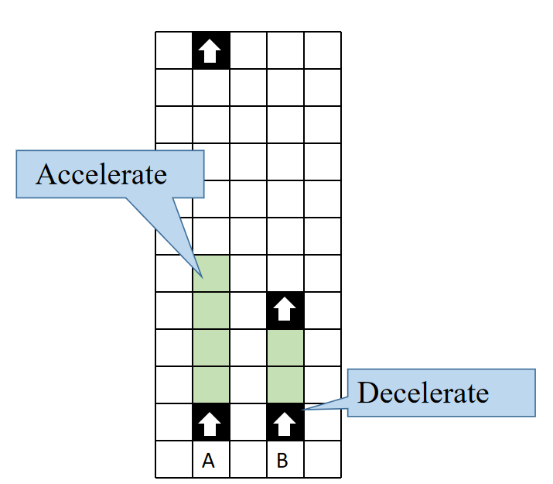

Car-following (Cont’d)
Introduce nonzero, variable acceleration: $a$
Set safety constraint based on different response time
safe distance = response time * velocity: $d_{s}=t_{r}v$
shorter for self-driving: $t_{r}$=1s (resp. $t_{r}$=2s)
Update position based on velocity and safe distance

Slide 10
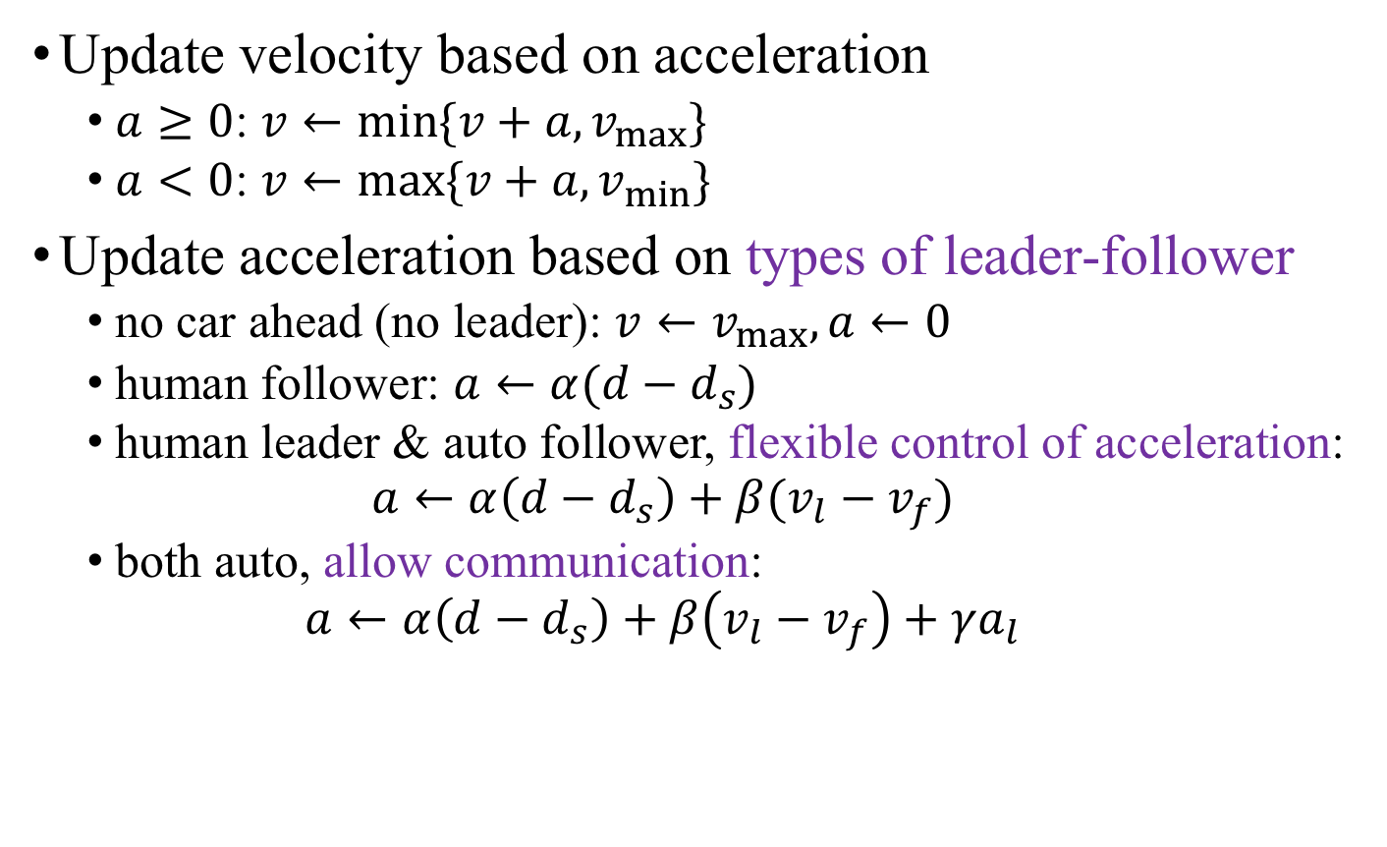
Car-following (Cont’d)
Update velocity based on acceleration
$a≥0$: $v←min\{v+a,v_{max}\}$
$a<0$: $v←max\{v+a,v_{min}\}$
Update acceleration based on types of leader-follower
no car ahead (no leader): $v←v_{max}, a←0$
human follower: $a←α(d−d_{s})$
human leader & auto follower, flexible control of acceleration:
$$a←α\left(d−d_{s}\right)+β(v_{l}−v_{f})$$
both auto, allow communication:
$$a←α\left(d−d_{s}\right)+β\left(v_{l}−v_{f}\right)+γa_{l}$$

Slide 11
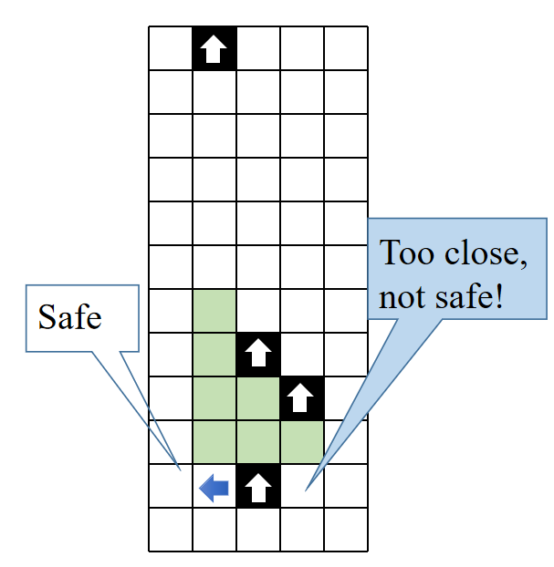
Lane-changing
Lane-changing maneuver
not enough space ahead
Safety constraint
safe after lane-changing
check forward and backward
safe distance based on types
Symmetric version
same for left and right lanes
Lane-changing probability

Slide 12
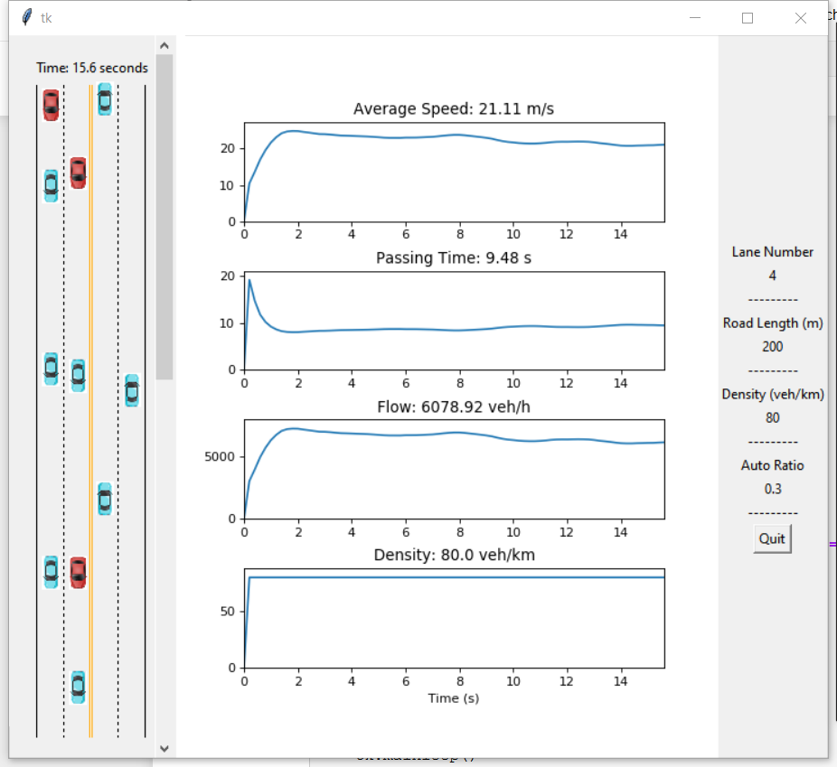
Simulation

Slide 13
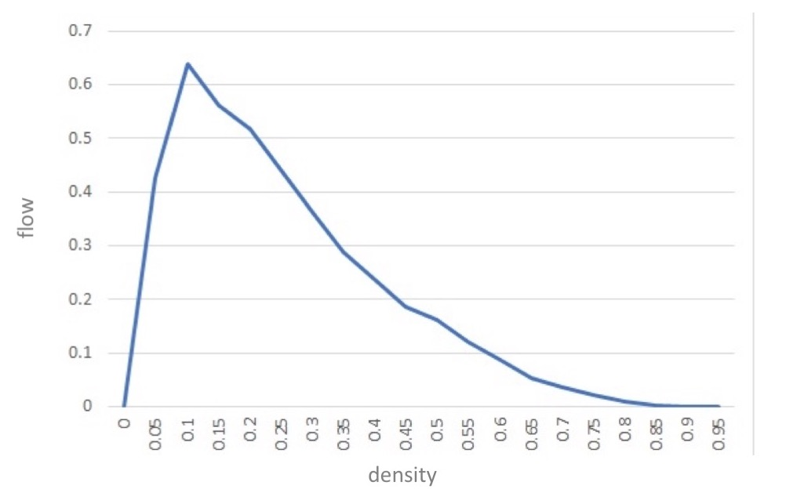
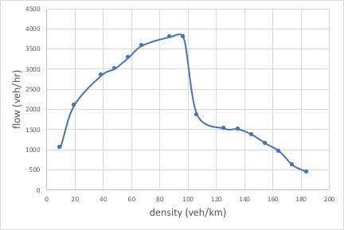
Analysis
Fundamental diagram
single lane
purely human-driven
pattern similar to NaSch

Slide 14
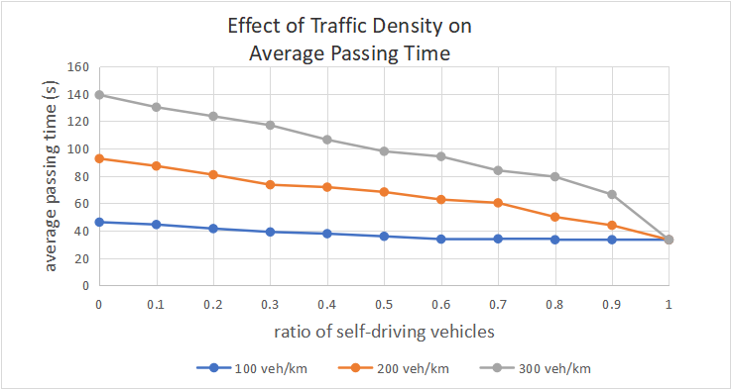
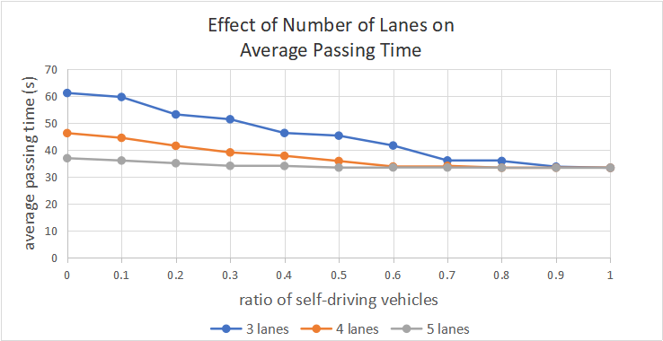
Analysis (Cont’d)
Effect of auto ratio
Auto can speed up traffic
Auto can alleviate traffic jam
Effect of number of lanes
More lanes can speed up traffic
Auto reduce the impact of lane number
Effect of traffic density
Auto reduce the impact of traffic density
Auto benefit highway capacity when traffic is heavy

Slide 15
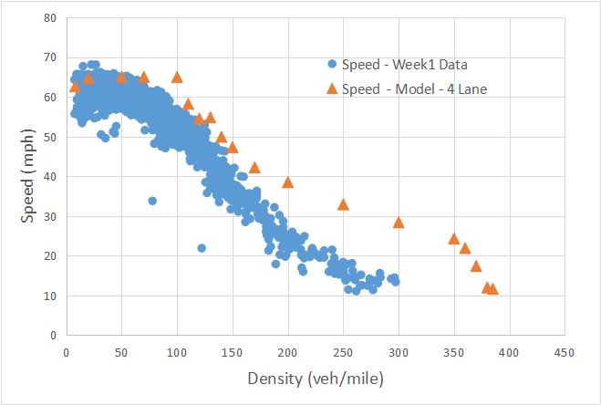
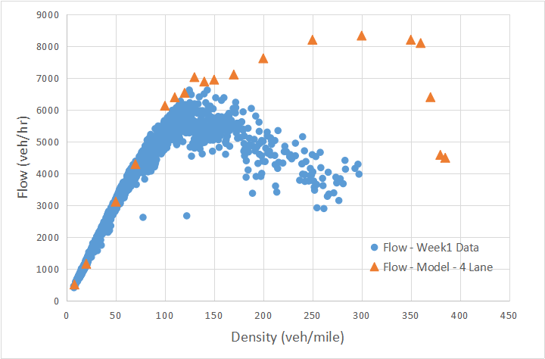
Analysis (Cont’d)
Compared with data from course Week 1

Slide 16
Conclusion
A framework of cellular automata is established to simulate the effects of self-driving cars on traffic flow
Compared to classic multi-lane CA models, we take the types of leader and follower into consideration by introducing response time and variable acceleration
Autonomous vehicles can improve traffic conditions

Slide 17
Thank you!
Q&A?

